Slide 1

Simulations in Drug Development
David Burt & Greg Cicconetti

Slide 2
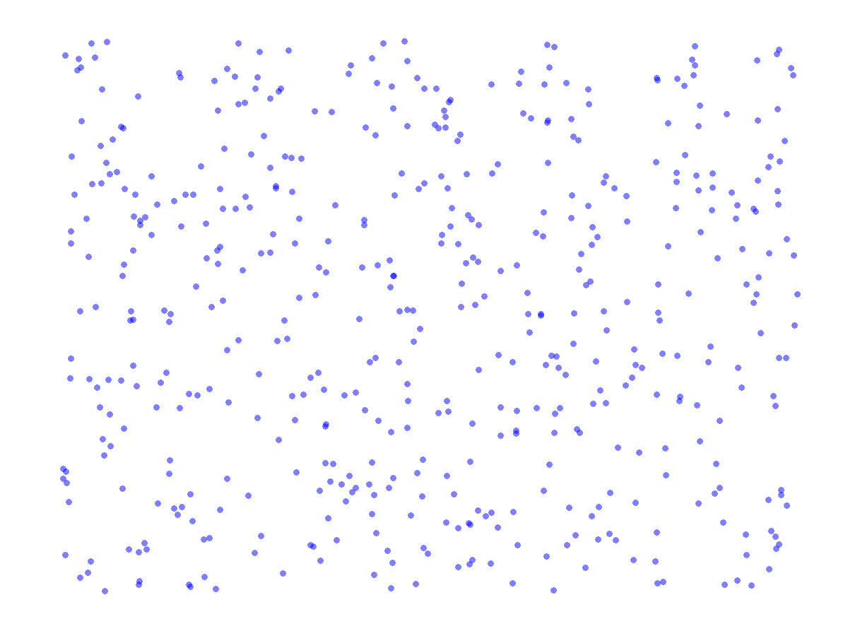
A Random Sample from the Unit Square is Overlaid on the Map
Entire Map is
2018.5 square miles
% of Points on Land:
150/500 = 30%
Estimated Land Area:
605.56 mi²
Land Area per Google:
596.7 mi²

Slide 3
Map Demo
Computing Oahu’s area analytically is difficult
Simulation
Simple and relatively accurate
Demos the use of simulation to compute area
Method analogous to rejection sampling technique
Many statistical problems are area computations or require area computations to solve

Slide 4
Objectives for course
Provide an introduction to statistical simulation
Contrast theory and iterative problem solving
Demonstrate simulation concepts via examples
Simulation planning
Communicating & drawing inferences from simulation
Focus is not on coding and syntax or deep theory

Slide 5
Course Outline
Welcome and Intro – David₆
Some Motivation for Simulation – Greg₁₀
Modelling Randomness – Greg₁₇
Enrollment Modelling – Greg₁₄
10 min Break
Simulating Correlated Data – David₁₀
An application using simulated correlated endpoints – David₆
Importance Sampling, Rejection Sampling, and Metropolis Hastings Simplified – David₁₀
Case study: Robustness of Efficacy to Early Withdrawers in an Outcomes Study – David₇
10 min Break
Case Study: Recurrent events – Greg₁₂
Simulation Size – How Large is Large? Greg₈
Closing remarks – David

Slide 6
Additional Material and References
Supplemental for Tutorial Session
Cicconetti, G., Burt, D. 2014. R Code to Accompany the Deming 2014 Simulation in Drug Development Tutorial.
Please email: gcicconetti@gmail.com
Distributional relationships
Leemis, L., McQueston, J. Univariate distribution relationships. The American Statistician, 2008. Vol 6. No. 1, 47. http://www.math.wm.edu/~leemis/2008amstat.pdf
Enrollment Modeling
Anisimov, V., and Fedorov, V. Modelling, prediction, and adaptive adjustment of recruitment in multicenter trials. Stats in Medicine. 2007, 26. 4958-4975
Correlated Binary Data
Qaqish B. 2003. A family of multivariate binary distributions. Biometricka, 90 (2) 455-463.
Simulation Size from a Sequential Estimation Perspective
Mukhopadhyay, N., Cicconetti, G. 2004. "How Many Simulations Should One Run?" In Applied Sequential Methodologies Real World Examples with Data Analysis (N. Mukhopadhyay, S. Datta, S. Chattopadhyay, eds.), 261-292. Marcel Dekker: New York
Paper’s Goal: Advertise 2-stage sequential sampling methodology in the setting of simulation size determination.
Multiple Imputation
Rubin, D.B., Multiple Imputation After 18+ Years. Journal of the American Statistical Association. 1996, 91. 473-489.
Assurance
O'Hagan, A., Stevens, J. W. and Campbell, M. J. (2005), Assurance in clinical trial design. Pharmaceut. Statist., 4: 187–201. doi: 10.1002/pst.175
Chuang-Stein, C. (2006), Sample size and the probability of a successful trial. Pharmaceut. Statist., 5: 305–309. doi: 10.1002/pst.232
Carroll KJ. Decision Making from Phase II to Phase III and the Probability of Success: Reassured by ‘Assurance’? 2013 Journal of Biopharmaceutical Statistics Vol 23(5): 1188-1200

Slide 7
Some Motivation for Simulation

Slide 8
How about a toy example?
How many times can I roll dice before going to jail when playing Monopoly?
Approaches
Think about it
Ponder rules and try to derive the distribution
Do it
Actually play the game, collect data, and fit to known distribution
Do it efficiently:
REPEAT {Edit a short program; run program; eat a snack; graph the results; if sufficient insight gained BREAK}

Slide 9
Simplify the Problem
Simplified rules:
40 spaces around square board. Play begins on space 0 ≡ 40.
Go to Directly to Jail: Space 30 → P(Jail) = 1
Roll doubles 3 times in a row → P(Jail) = 1
Chance cards: Spaces 7, 22, 36 → P(Jail) = 1/16
C. Chest cards: Spaces 2, 17, 33 → P(Jail) = 1/16

Slide 10
Pseudo-code for the Monopoly Question
Each iteration performs the following:
Simulate roll of two dice
Update position on the board
BREAK if any of these occur
Past 3 rolls are doubles
Board position is space 30 (Go Directly to Jail)
Board position is a Chance space & random card → Jail
Board position is a Com. Chest space & random card → Jail
Each iteration should store:
Values for first and 2nd dice
Position on board
Reason for going to jail

Slide 11
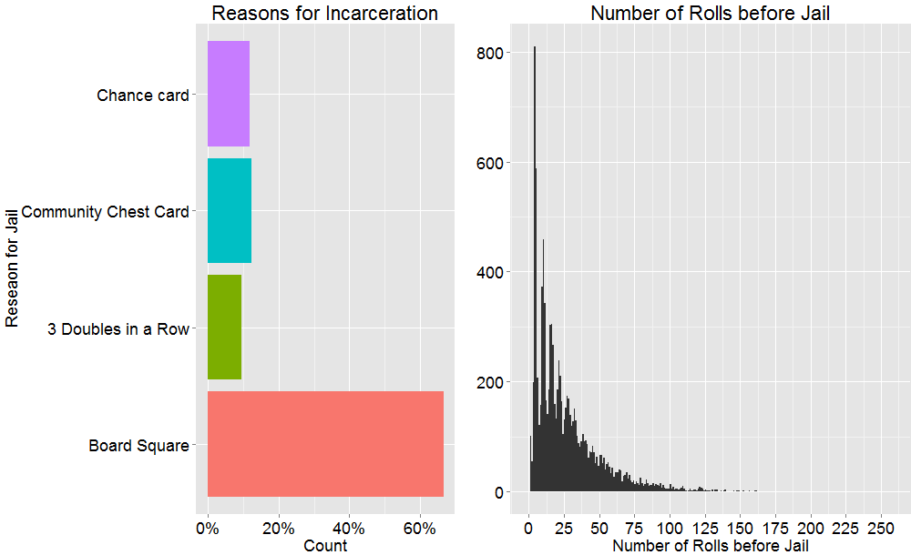
What does simulations suggest?

Slide 12
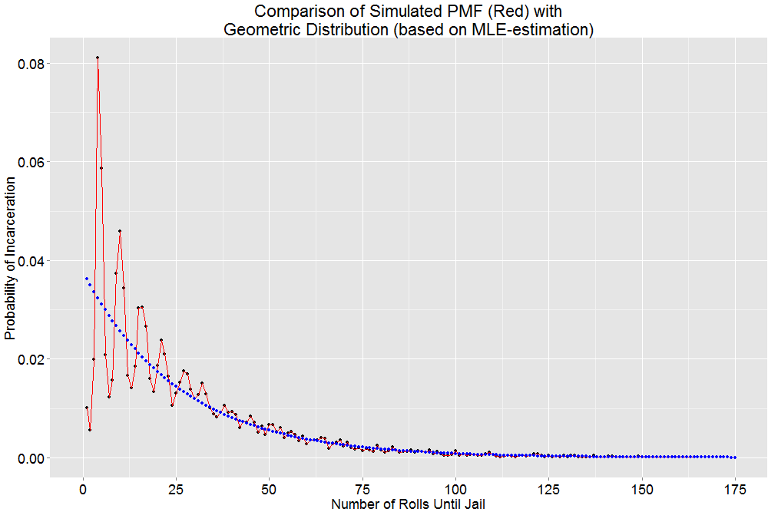
How is the Number of Rolls Until Jail Distributed?

Slide 13
The appeal of simulation
Once we have an understanding of the behavior in one setting, it’s easy to propose and study variations. E.g.,
Add our own additional community chest/chance cards
Replace the 3-doubles-in-a-row rule with a 4-doubles-in-a-row rule
We can also look towards refining the current problem to make it more realistic…
Our simulation presumes we’re playing in a vacuum
How long does a typical game last? In practice would we encounter censored data?

Slide 14
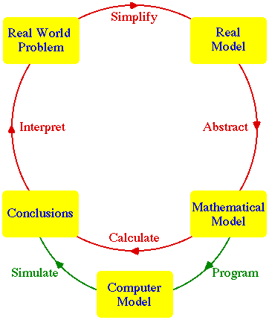
Simulation as a tool in the problem solving/modelling cycle
Overall Objective: Make Wise a Decision
Environmental
Issues
Tools/Expertise
Literature
Similar Problems

Slide 15
Why run a simulation in the first place?
Analytical evaluation may be impossible, highly time-consuming, or be a low yield endeavor
You want to vet your working assumptions in a controlled environment
You want to contrast methodologies
You need to manufacture knowledge

Slide 16
Simulation in Drug Development
Planning
Study design, enrollment modeling, milestone projection, performance of decision making rules
Monitoring
Similar to above – but now you have to incorporate data
Analysis
Case study: exploring recurrent event methodologies
Case study: simulation study to explore impact of early withdrawers in an outcomes study
Ancillary problems in clinical statistics

Slide 17
Components of a Simulation
Motivation: you need a well-defined problem
Confounded by variability issues
Random elements
To mimic our real-world problem
Repetition
A focused set of retained measurements
To facilitate decision-making/problem restatement
Tables/figures
For digesting & communicating results
Notes:
Probabilistic statements might be things like:
the endpoint follows a normal distribution with mean mu and SD sigma
the events occur according to a Poisson distribution with mean mu etc.

Slide 18
Modelling randomness

Slide 19
Random Number Generators
All random functions in common use are pseudo-random
Congruential generators
Deterministic
Mimic the properties of a sequence of independent uniformly distributed random variables
Based on modulo arithmetic and primes
They offer a useful source of randomness that can be transformed into any other statistical distribution
Good Practice: Set the seed when you’re making simulations official or need to ensure repeatability
Simulations to support arguments for FDA, publication, etc.
Creating reproducible examples for students/colleagues.

Slide 20
Manufacturing random variables: Old School
The ‘punch card story’ updated for mid 90s:
You can simulate from Unif(0, 1)
You have a calculator and a good math-stat book
Let U ~ Unif(0, 1)
X = (R – L)U + L ~ Unif(R, L)
Y = ln(1/U) ~ Exp(1)
Z = Y/λ ~ Exp(λ)

Slide 21
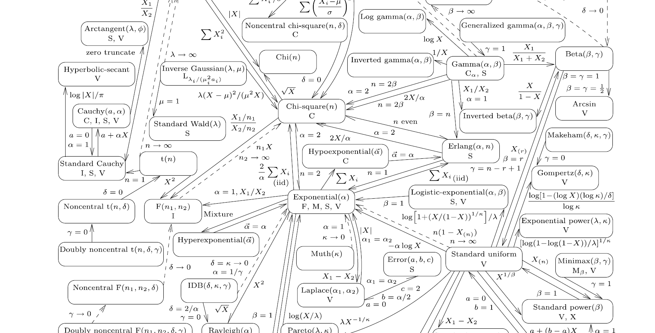
A Nice Reference
Leemis, L., McQueston, J. Univariate distribution relationships. The American Statistician, 2008. Vol 6. No. 1, 47.
http://www.math.wm.edu/~leemis/2008amstat.pdf

Slide 22
Manufacturing random variables: New School
Distribution | SAS | R
Uniform | RAND(‘UNIFORM’,…) | runif()
Normal | RAND(‘NORMAL’,…) | rnorm()
Binomial | RAND(‘BINOMIAL’,…) | rbinom()
Poisson | RAND(‘POISSON’,…) | rpois()
Exponential | RAND(‘EXPONENTIAL’,…) | rexp()

Slide 23
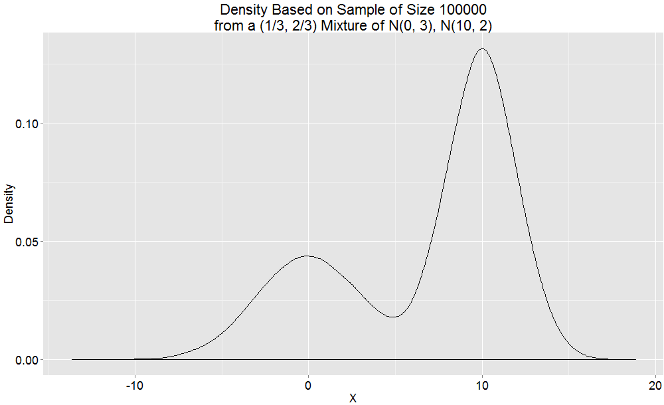
Mixing Your Own Random Variables
Iterate to a realistic model…
Sample from a Bernoulli(p = 1/3)
If 1: sample from N(0, sd=3)
If 0: sample from N(10, sd=2)
Notes:
plot(density(c(rnorm(n=100, mean=0, sd=2.5),
rnorm(n=50, mean=10, sd=2.5))),
main = "My normal mixture")

Slide 24
The Inverse CDF Method for Generating Random Observations
The Inverse CDF method assumptions
You can simulate from Unif(0, 1)
You can compute the inverse of your CDF
Theorem: Let F be a CDF and U ~ Unif [0, 1].
Define: Y = F⁻¹(U). Then Y ~ F.
E.g., CDF of standard exponential
F(x) = 1 – e^{-x}
F⁻¹(t) = –ln(1 – t) = ln(1/(1 – t))
Replace t with random uniforms to get a random observation from distribution F.
Contrast w/ couple of slides back

Slide 25
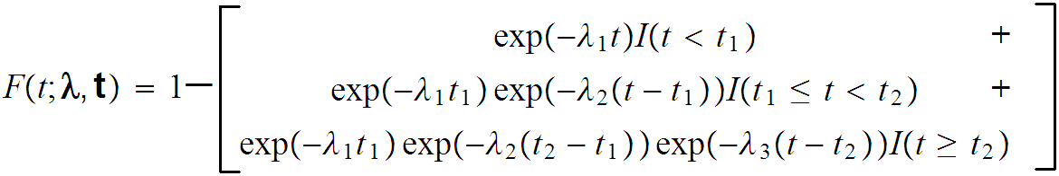
Inverse CDF Method
Real example: piecewise exponential needed for an outcomes trial to model time to event in an acute patient population.
For early work this CDF was inverted and coded along these lines
For R folks: ‘There’s gotta be a package for this…’
See the rpexp function in the MSM package
Notes:
Some times this is hard and you may find a canned solution- don’t waste time – candidate for deletion

Slide 26
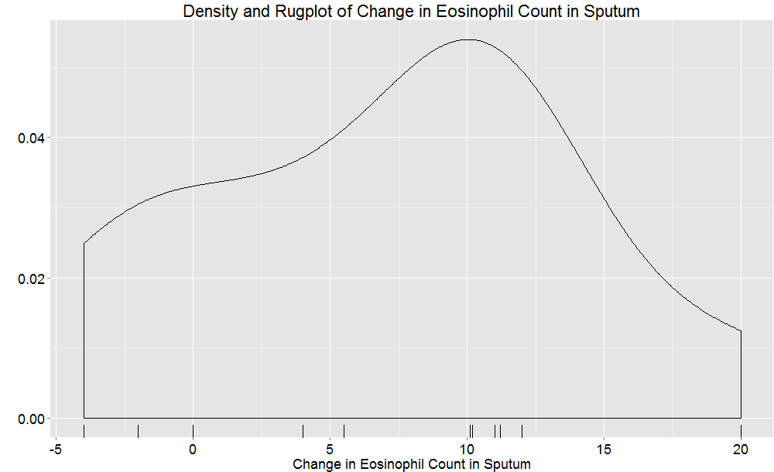
Inverse CDF Method - Application
You want to simulate Changes in EOS Count, but you have sample size issues and heavy tails…
What can you do?
Note: this density plot emphasizes the heavy-tailed nature of the data.

Slide 27
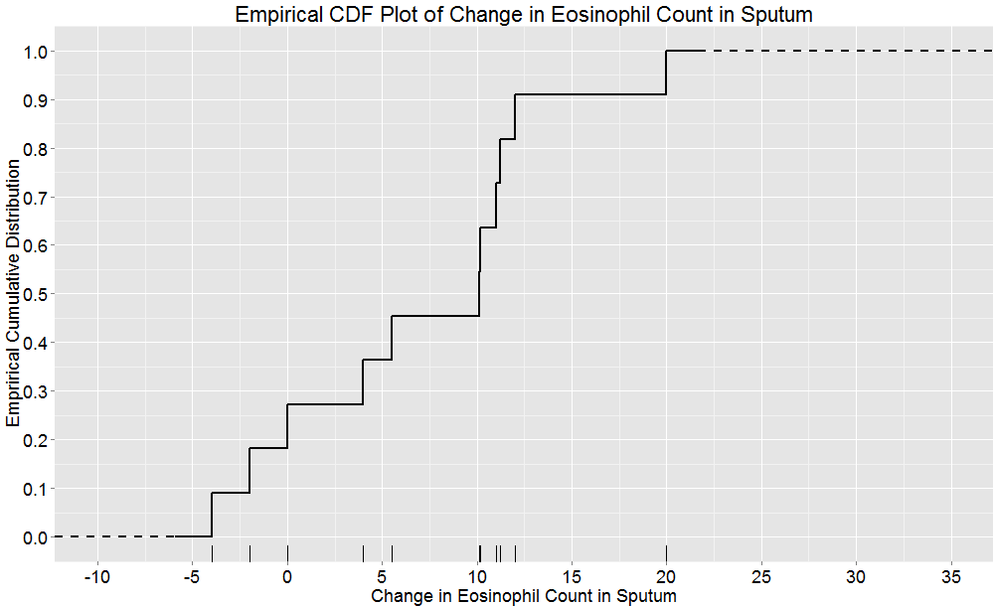
Inverse CDF Method - Application
Justification: We are applying our previous theorem to the empirical CDF.
Analog: Bootstrap
Critique: We’ll run into repeats and we may miss modeling heavy-tails
Q: Can we circumvent?

Slide 28
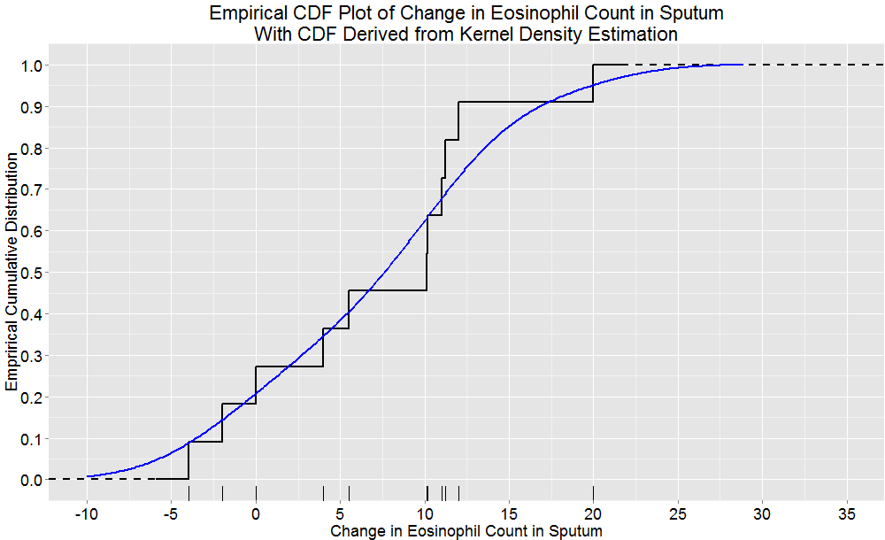
Use the CDF obtained from a Kernel Density Estimation
Note: Solves the issue with repeats. 10% of the time values will be below lowest observed, 5% of the time above highest observed.

Slide 29
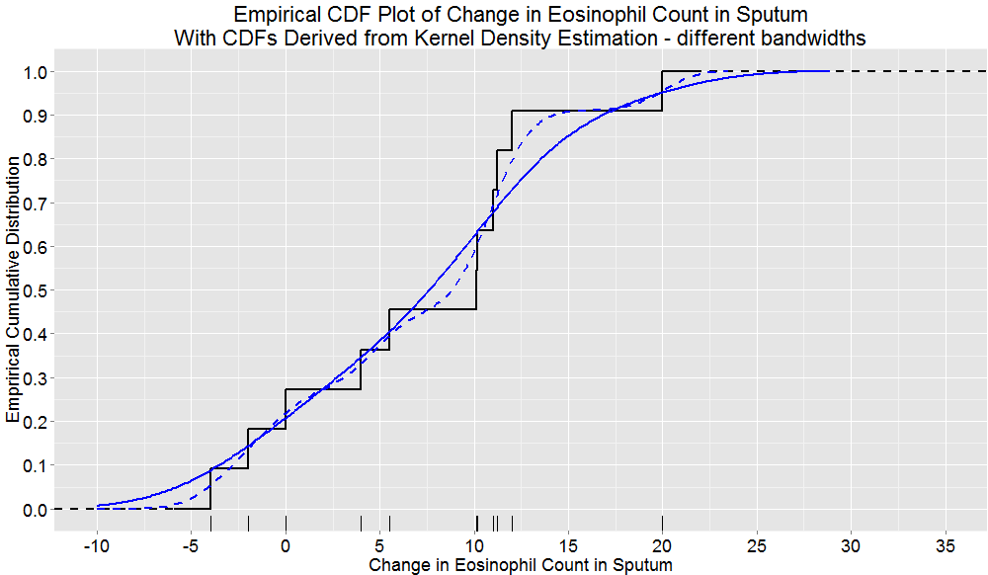
Use the CDF obtained from a Kernel Density Estimation
More tinkering…

Slide 30
Pseudo-code for sampling from a Kernel Density Estimate-based eCDF
Data → Kernel Density Estimate (KDE)
KDE produces a collection of x and y values used to plot your density
Nuisance issues for this discussion:
What range should be used for x-values and how dense should it be?
KDE parameters (kernel function, bandwidth)
KDE → KDE-based eCDF
Use the x and y values from KDE to approximate the integral over sequence of x values
Randomly generate a uniform, U
Identify which of the y-values associated with KDE-based CDF is closest to U. Call it y_{U}
Your random observation is the corresponding x-value, X_{U}

Slide 31
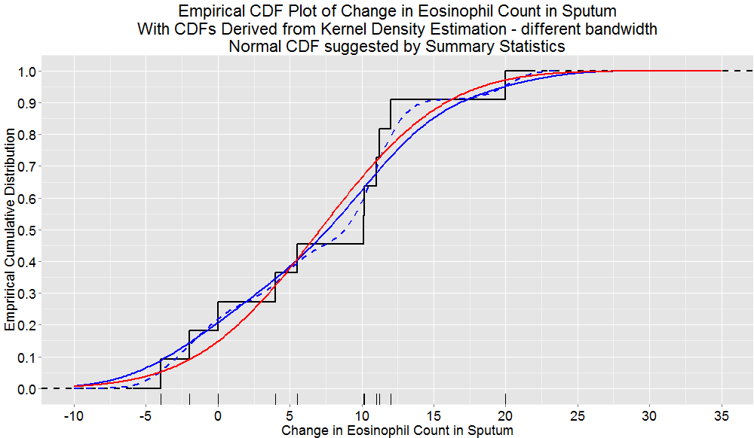
Contrast with the Normal CDF (MLE-estimates)

Slide 32
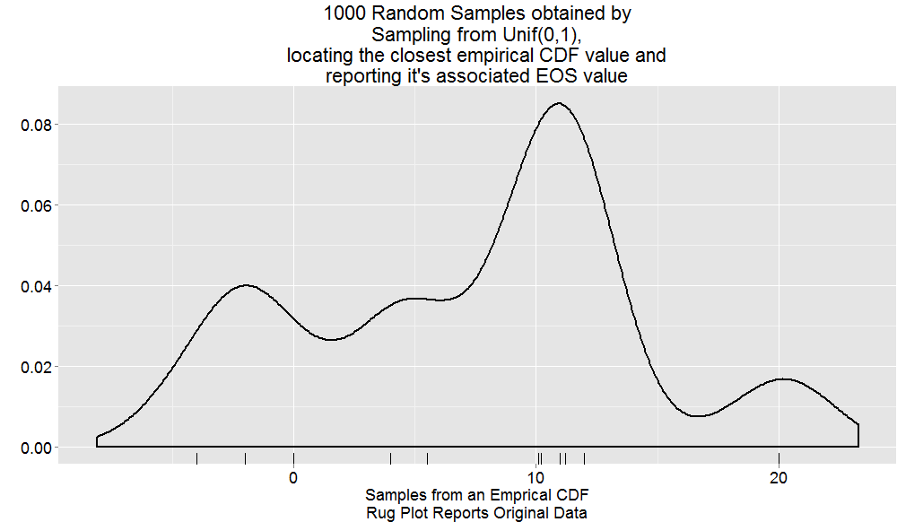
Sanity check – Does this make sense?
This example uses the ‘dotted-blue’ KDE-based eCDF
Check what you’ve created… does it make sense?

Slide 33
More variations on the theme
Let’s investigate how this approach performs
Repeat many times:
Sample from EOS data: X
Generate some random error: e
Your choice: Uniform [-L, L] or normal(0, sd = s)
Retain: y = X + e
Explore what you’ve created
Get some summary statistics; characterize the mean and variance
Plot some histograms/densities to characterize the shape
Repeat for a series of error specifications that have increasing variance and observe how this influence your summaries.
Can you dial this method in and forego the complicated coding required by the KDE-based eCDF approach?

Slide 34
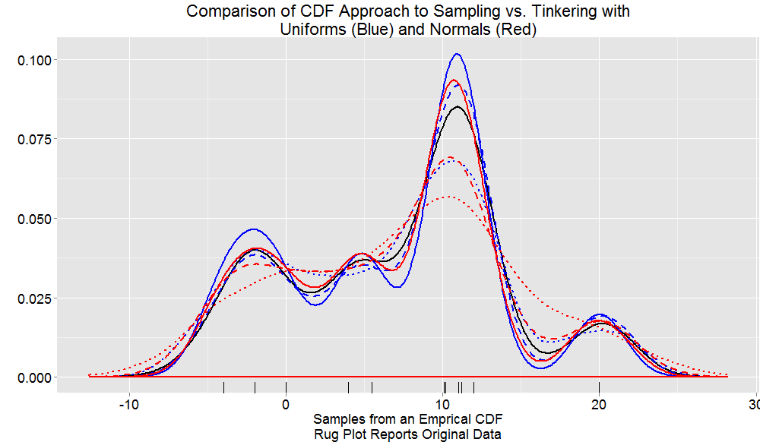
Comparisons
Reds: Normal with sd = 1, 2, 3
Blues: Uniform with L = 1, 2, 3

Slide 35
Discussion
We’re sampling from weird distributions
Critique if next study is small: Justify using t-test
I.e., ‘n-should-be-at-least-30-for-CLT-to-kick-in’ rule
Repeat for k in {2, 3, …, 100}
Repeat a large number of times
Sample k observations from distribution F
Compute mean of k observations
Standardize the k observations
Compare these with a standard normal distribution (grab K-S test stat?)
Plot 2, 3, 100 vs. K-S test stat
Notes:
Skip if neccesary

Slide 36
Simulating Enrollment Data

Slide 37
Motivating Enrollment Modeling
Study conduct
Safety analysis based on a cohort in study 1, triggers planning for study 2
Timing of interim analyses
Assessing Futility Rules
How many subjects will be randomized during deliberations?
How many subject might be spared from randomization if trial stops?
Adaptive Designs
Simulating enrollment is a key element in the overall simulation of a continuous response adaptive clinical trial
Contingency Planning
Business needs: timing is everything

Slide 38
Some (perhaps overly simplistic) approaches to modeling enrollment
Assumed known: enrollment start and stop dates
Uniform Enrollment
Implication: All centers are up and running on Day 1
Stepwise Uniform: Enrollment has k periods
With known start and stop dates
Likelihood of enrollment during periods varies, but within each period enrollment is uniform.
Center initiation phase: Enrollment rate is increasing
Steady state phase: Enrollment rate is at steady state
Closeout phase: Enrollment rate is decreasing
Scaling by a continuous distribution: Beta(a, b)

Slide 39
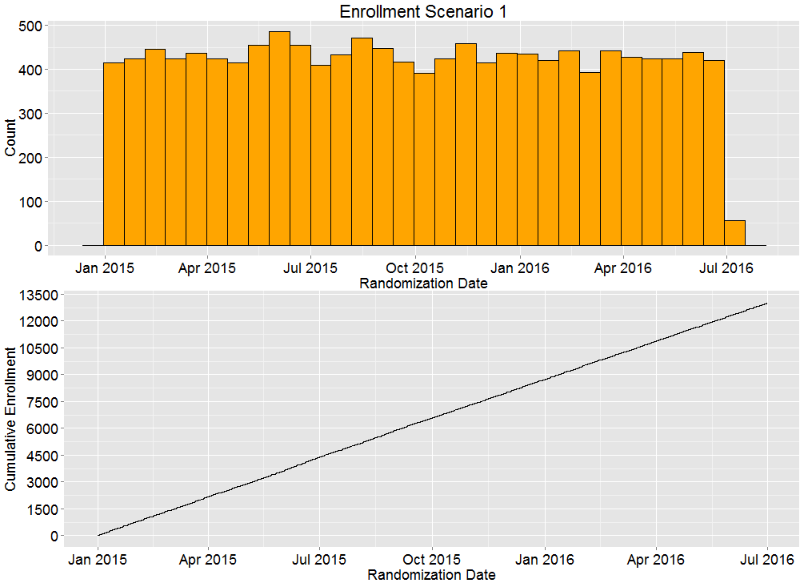
Uniform Enrollment

Slide 40
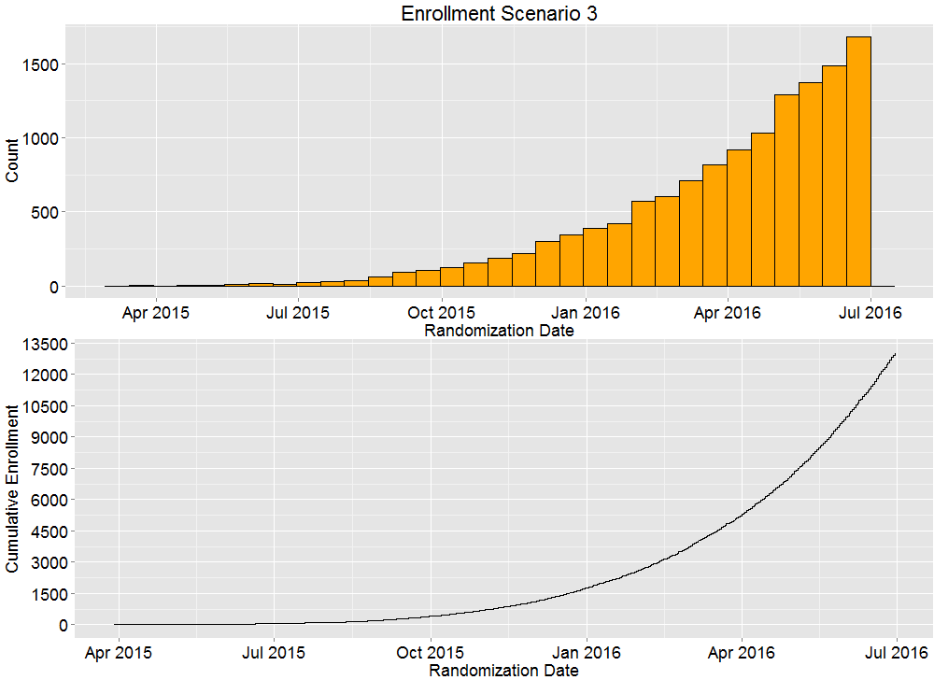
Scaled Beta: Beta(5, 1) provides model

Slide 41
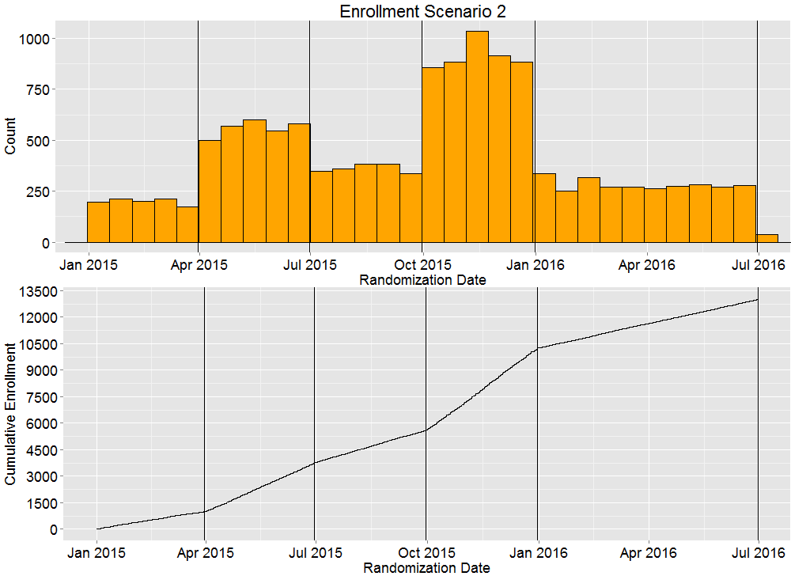
Stepwise Uniform
Notes:
This is how FACTS and EAST thinks about enrollment

Slide 42
Challenges to Macro-level Modeling
Modeling with gross knowledge of center-initiation information
One idea – enrollment is quadratic while centres are still coming on board, linear thereafter
But Contingency Planning is complicated
Complicated here means: coding & communicating headaches
What is the impact of shutting down one of the strata from our study? E.g., % of Subject with condition X is higher than protocol anticipated.
Models could attenuate the slope…
A Country anticipated joining study in April. Delays may push this back to October. Represents 15% of planned centers.
Model culprit country separately

Slide 43
Modeling enrollment at the centre-level
Disclaimer: I’m purposefully tinkering…
The following assumptions are figments of my imagination
Getting code in place; exploring how various components interact
Building a set of refined questions for my literature search and colleagues
My toy assumptions
9 countries are to participate
Each country plans to have 10 centres; all centres active within 90 days
First Centre Initiated: FCI_{i} ~ DiscreteUnif(1, 180), i = 1,…,9
Rest of Centres: CI_{ij} ~ FCI_{i} + DiscreteUnif(1, 90), j = 2, …, 10
Country-level enrollment rates taken as known or sampled
CE_{i} ~ Unif(.2, .8)
Centre-level enrollment rates taken as known or sampled
Conditionally distributed CE_{ij} ~ Beta(20CE_{i}, 20-20CE_{i})
Given centre-level rates, enrollment ~ Poisson process
Ignore centre-level shutdown complication

Slide 44
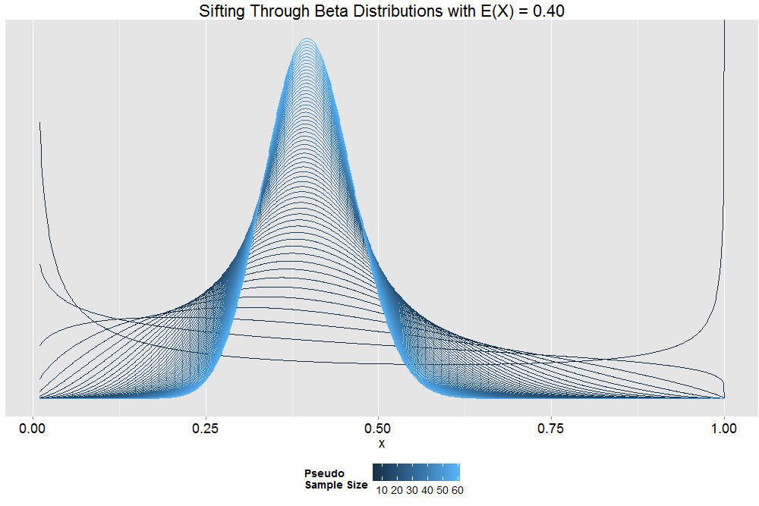
Tinkering + Theory
Then if Y ~ Beta(a’b’, b’-a’b’)
EY = a’;
b’ plays a ‘pseudo sample size’ role

Slide 45
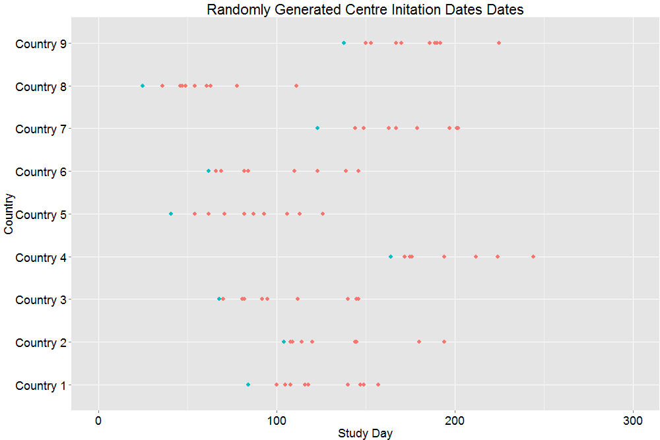
Centre-Level Modeling: Centre Initiation
Can I get colleagues to suggest improvements?
Perhaps the distribution should be right-skewed instead of uniform? Known outliers?

Slide 46
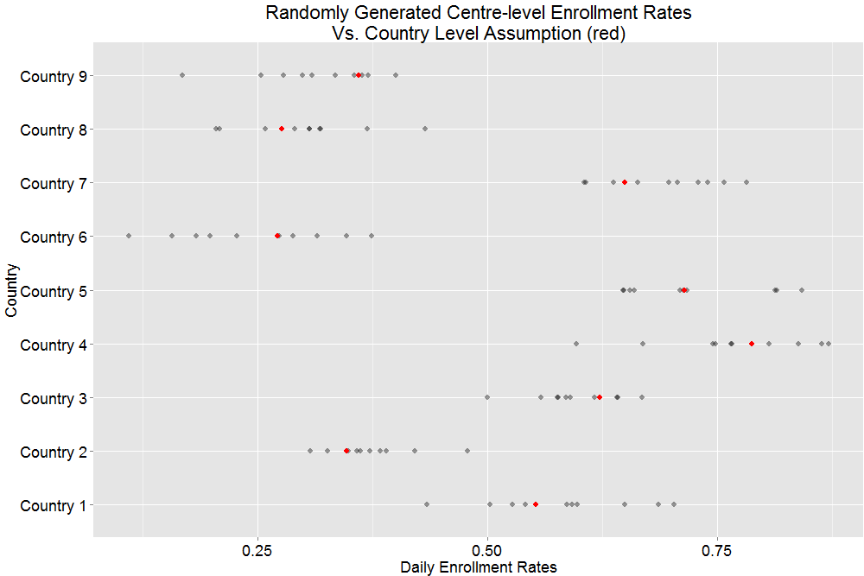
Centre-Level Modeling: Rates

Slide 47
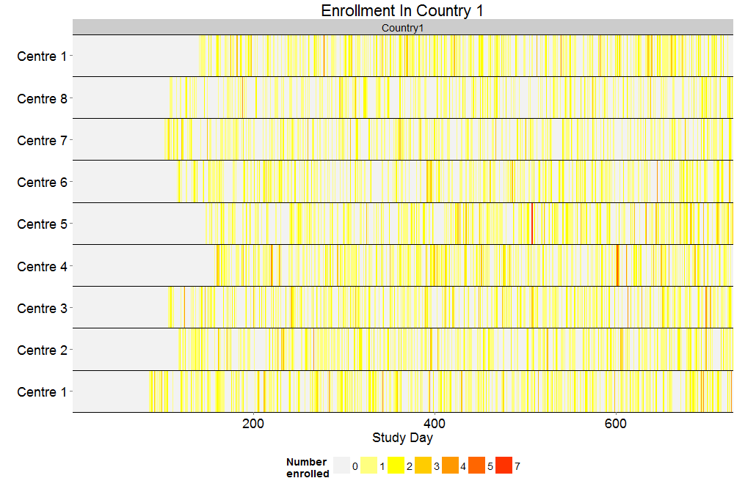
Visualizing the Point Process

Slide 48
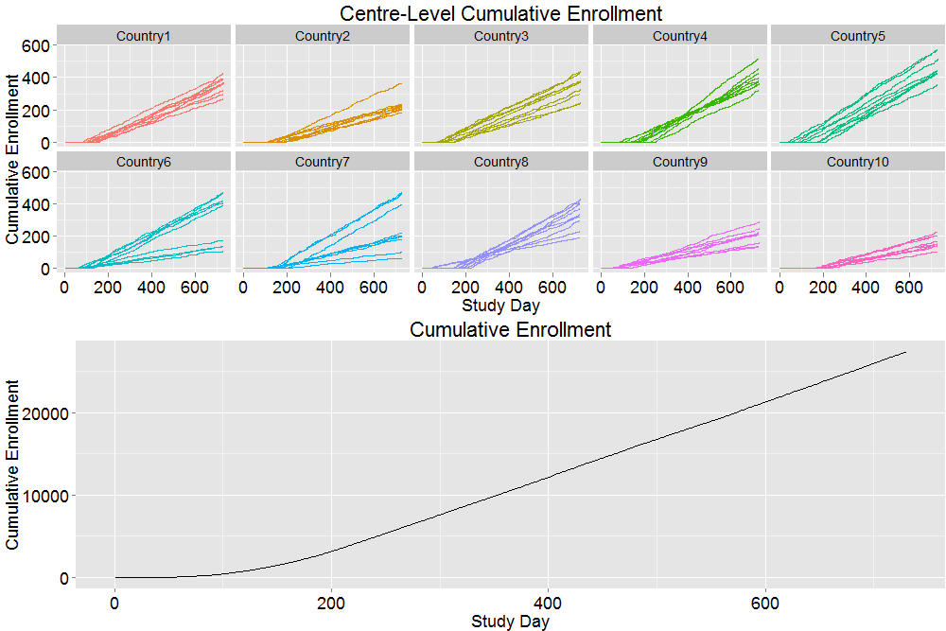
Visualizing Enrollment

Slide 49
How are others attacking the problem?
Prior for centre’s enrollment rate ~ gamma
Data: k enrolled over n days ~ Poisson
Posterior dist of enrollment rates ~ gamma
Replicate along lines here to visualize how enrollment evolves
Predictive distribution of # enrolled at later day ~ Negative binomial
Use this for efficiently predicting enrollment on certain dates
Please see references.

Slide 50
The Devil’s in the Details
Country/Centre Start up assumptions
How sensitive are working assumptions?
How reliable are working assumptions?
How often are operational colleagues updating their assumptions? How quickly are they communicating?
How reliable are initial estimates of enrollment rates?
In anticipation of data:
How quickly do enrollment parameters update with the data?
How are you going to condition on the incoming data?
Problems to come when data start rolling in:
How to adjust for reporting lag
How to model enrollment closeout
In event-driven trials:
How do you roll up enrollment modeling with event counting?

Slide 51
Building Correlation into Simulated Data

Slide 52
Introduction
When components of process are correlated, correct stochastic imitation can only be achieved when the correlation between these components is appropriately incorporated in the algorithm
This module is intended to provide specific algorithms and guidelines for simulating correlated random variables so that processes that have correlated components can be adequately imitated

Slide 53

Basic Idea for Simulating Correlated Data
Step 2
Generate 2 other random numbers
Step 3 Repeat
Step 1 Generate 1 random number
Add
Sum 1
Sum 2
Sum 1 and sum 2 will be correlated

Slide 54

Correlated Creation
Simulate 100000 random variables
X ~ Uniform[20, 30]
For each one:
Variation 1 = X + Uniform[-5, 5]
Variation 2 = X + Uniform[-5, 5]
Question: What have we created?
To understand, compute your basic summary stats
Means, SDs, Correlation
Make changes iteratively to reflect reality

Slide 55
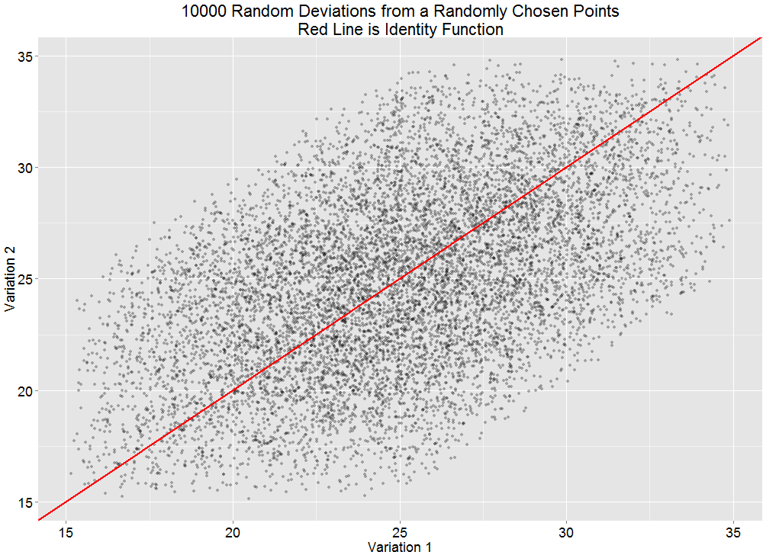
Correlated Creation: Positive Correlation
variable n mean sd cor
variation1 10000 24.99239 4.056005 0.4984801
variation2 10000 24.92245 4.062412
Sanity Check
variable mean sd cor
Variation1 24.992 4.056 0.498
Variation2 24.922 4.062

Slide 56
See Course Code
Negatively correlated data
Previous example + linear transformation
Correlated count data
Along lines of previous example
Poisson start values
Discrete uniform additions

Slide 57
Summary of Random Effect Simulation
Simple to implement
No restrictions on the choice of the sampling distributions for the two random components
Extensions to more complicated models
Y_{ij} = Complicated Linear Model + Subject_{i} + e_{ij}
Y_{ij} = Complicated Non-linear Model F(Subject_{i}) + e_{ij}
The normal distribution is usually used to model the errors
Notes:
The normal distribution is usually used for both since the sum of normal random variables has a normal distribution

Slide 58
Multivariate Normal
The algorithm is simple to implement and very efficient in terms of computer time
General concept
Simulate iid standard normal random variables
Apply an appropriate linear transformation
Correlation structure is user-defined

Slide 59
Multivariate Normal (Linear Transformation)
Univariate Analog
Z ~ N(0,1)
X ~ N(μ, σ²)
Multivariate Transformation
Z ~ MVN(0, Ι)
X ~ MVN(μ, Σ)

Slide 60
Correlated Binary Data & the Multinomial Distribution
The multinomial distribution can specify the joint distribution of correlated binomials
Multinomial Representation of Bivariate Binomial
Random Variable | Efficacy Response (Y₁) | Occurrence of AE (Y₂) | Probability | Observed Count
X₁ | Yes | Yes | P₁ | x₁
X₂ | Yes | No | P₂ | x₂
X₃ | No | Yes | P₃ | x₃
X₄ | No | No | P₄ | x₄
The Xs are random variables that represent the number of subjects (counts) out of a sample of size n that fall into a given category
Notes:
For the sake of simplicity we limit the scope of this module to the bivariate case! Note that Xs are numbers in a given category out of the total number of subjects n.

Slide 61
Correlated binary data example
There are simple formulas for the Ps in terms of univariate proportions and the correlation coefficient in the bivariate case.
Ps are not unique for more than 3 dimensions.
Correlated Binary Data Example N=200
Random Variable | Efficacy Response (Y₁) | Occurrence of AE (Y₂) | Probability | Observed Value
X₁ | Yes | Yes | P₁=0.75 | X₁=151
X₂ | Yes | No | P₂=0.05 | X₂=7
X₃ | No | Yes | P₃=0.10 | X₃=19
X₄ | No | No | P₄=0.10 | X₄=23

Slide 62
General guidelines
Obey all the rules
The user-specified correlation matrix should be supported by historical data or valid assumptions
Consider assessing the sensitivity of the simulation to various correlation structures
Check what you’ve created!

Slide 63
A post-hoc post-mortem analysis: an application using simulated correlated endpoints

Slide 64
Problem Setup
Study conclusion: Retain the null
Follow-up: Well, what is the likelihood that of the 15 primary and secondary endpoints we studied, 12 yielded estimates on the favorable side of the null?
Back of the envelope calculation:
Appeal to the binomial distribution
N=15, p=0.5: P(X > 11) = 0.01757812
Critique: These are not independent coin flips!

Slide 65
An Investigation Via Simulation
Let θ = log(HR), an estimate of θ based on m events is distributed approximately as:
In k dimensions, consider
Where D is a diagonal matrix holding 4/m_{i}
R is a specified correlation matrix

Slide 66
A Simulation Plan
For j in {0, .05, …, .9} Repeat:
Randomly generate MVN_{k}(0, DR_{j}D’)
Count number of components < 0 [HR < 1]
Compute the eCDF for ‘# of HRs among 15 < 1’
Contrast with Naïve Binomial Example (accomplished when j = 0!)

Slide 67
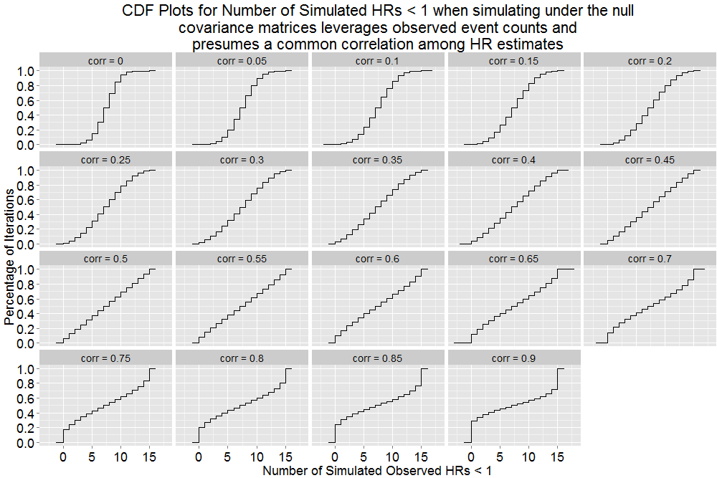
Behavior of eCDFs as correlation increases

Slide 68
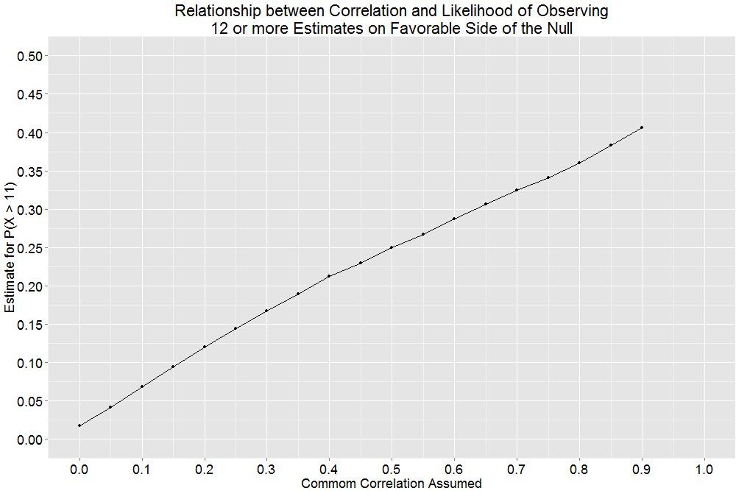
Behavior of P(X > 11) as correlation increases
Sanity check 2:
Sanity check 1:
P(X > 11) = 0.01757812

Slide 69
One Last Request
Colleague: This was a helpful exercise, could you repeat this with my correlation matrix – this should better reflect reality: R_{colleague}
Recall the rules
Reply: Alas, your correlation matrix wasn’t positive definite. Here are results using this modification to your original: R_{alternate}

Slide 70
Importance Sampling, Rejection Sampling and Metropolis Hastings Simplified

Slide 71
Simulation as a tool in the problem solving/modelling cycle
Overall Objective: Make Wise a Decision
Environmental
Issues
Tools/Expertise
Literature
Similar Problems

Slide 72
Importance Sampling Demo
Start
Rare Event 1/1000
One Complicated Action
One Result
NO
Repeat
Another Complicated Action
Another Result
YES
Overall Simulation Result

Slide 73
Importance Sampling Demo
Start
Non-Rare Event 1/2
One Complicated Action
One Result
NO
Repeat
Another Complicated Action
Another Result
YES
Overall Simulation Result
999 X
One Result
Another Result

Slide 74


Importance Sampling
Start
Repeat
Spectrum of Complicated Actions and their Associated Results
Alter the distribution
Compute an appropriately weighted average

Slide 75
XX% Bayes Prob
Simulated Probability we would go to phase 3 for various compounds
Drug | Prob | Reference
fluticasone | 98.2% | Palmqvist_2005
budesonide | 97.7% | Leigh_2002
xolair | 94.6% | Rensen_2008
montelukast | 69.6% | Leigh_2002
pranlukast | 63.5% | Obase_1998
XXX-999 | XXX% | STUDY200
roflumilast | 19.5% | Schalkwyk_2005
IL-5 | 2.9% | Palmqvist_2005
PBO | 0.9% | STUDY200
Late asthma response less than 50%
Yes
Go to Phase 3
No
Yes
Late asthma response better than PBO
XX% Bayes Prob
XX% Bayes Prob
LAR better than PBO
EOS or PC₂₀ better than PBO
Yes
No
No
Do NOT Go to Phase 3
Overall Decision Tree to be used to assess rank the compound among others in the same therapeutic area

Slide 76
Importance Sampling Summary
The rare events are important
So we sample them more often that we would usually
Then adjust the final result accordingly
Method can improve the precision of the simulation result in instances where small probabilities are involved
Can greatly reduce the number of simulations needed

Slide 77
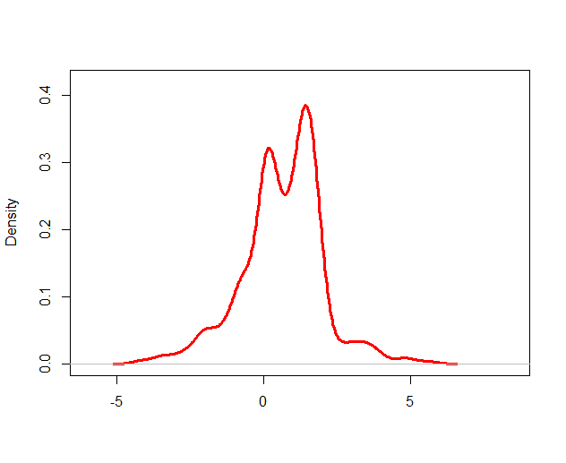
Rejection Sampling: Density function g(x) is easily evaluated, but can not be easily integrated
Notes:
Think about multiple dimensions. One dimension shown here for simplicity.

Slide 78
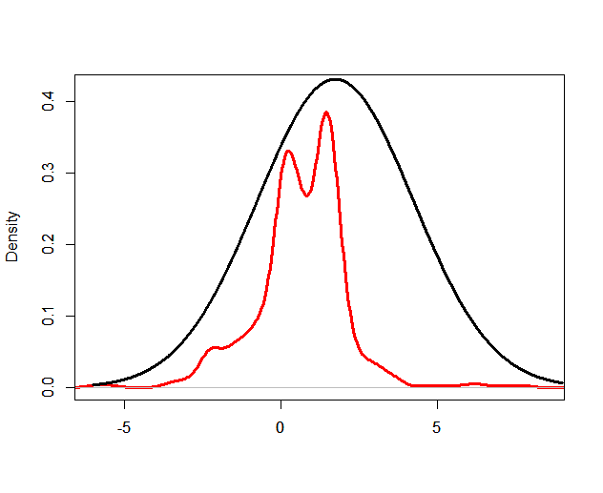
Find a density function f(x) that can be easily sampled from and evaluated that envelopes the target distribution
f(x)
g(x)

Slide 79
Sample x₁ from f(x) and compute g(x₁)/f(x₁)
f(x₁)
g(x₁)

Slide 80
Draw random c₁ from uniform(0,1) distribution and compare to g(x₁)/f(x₁). If c₁ > g(x₁)/f(x₁) then reject x₁
Reject
Commonly used for Bayesian analyses
Accept

Slide 81
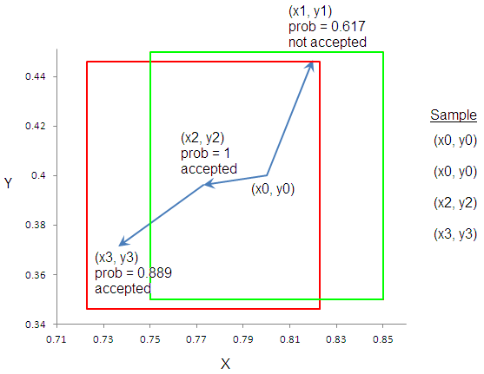
Metropolis-Hastings Simplified
Accept (x₁, y₁) with probability =

Slide 82
Case study: Robustness of Efficacy to Early Withdrawers in an Outcomes Study Assessing the Sensitivity of Missing not at Random

Slide 83
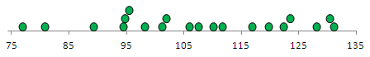
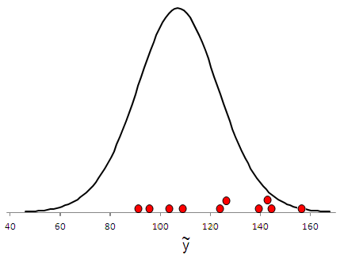
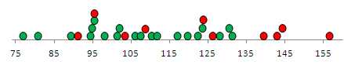
Multiple Imputation Demo
Raw data with 10 missing values
Analyse each complete data set
Summarize the results
Appropriate random imputation mechanism
Repeat
Complete data with imputed values
Notes:
The appropriate random imputation mechanism is opposed to fixed mechanism such as LOCF or Worst Case. The mechanism can be chosen in such a manner to assess sensitivity to missing mechanisms as described in the following case study

Slide 84
Phase III Setting
Study enrolls Coronary Heart Disease patients
Endpoint: time to first MI/Stroke/CV Death
Annualized event rate: 4.0%
Annualized withdrawal rate: 1%
Motivation: Explore the impact of study withdrawers on hazard ratio estimate associated with the primary analysis
If the number of withdrawers is large, it is easy to criticize efficacy with ‘what if’ arguments.
Plan: use of simulations to impute data for withdrawers during the unobserved time range between the withdrawal date and end of study (EOS)
EOS taken as midpoint of end of study window

Slide 85
Primary Analysis vs. Iteration
Original data for
subjects who did not withdraw
Original data for
Subjects who did not withdraw
Original censored data for subjects who did withdraw
Simulate data for
subjects who did withdraw
Cox PH:
Primary Analysis
Cox PH:
Sensitivity
Notes:
Imputation: for each subject who withdrew from the study prior to experiencing a MACE event, impute a (possibly censored) time to first occurrence MACE
Times are to be randomly drawn from an [piecewise] exponential distribution [piecewise exponential] fit to placebo subjects and with parameters adjusted based on various HR values
Analysis: Combine the observed data from all subjects who completed the study and with these imputed times for subjects who withdrew from the study. Re-run the primary analysis (Cox proportional hazards model with treatment as the only covariate)
Retain the resulting hazard ratio for the treatment effect from this Cox proportional hazards model

Slide 86
A Simulation Scenario
When imputing times for those who withdrew from the study prior to experiencing the primary endpoint a scenario is a particular combination of
an annualized placebo event rate and a
hazard ratio for the treatment effect
The distribution of the hazard ratio estimate obtained over 500 iterations is summarized

Slide 87
The Simulation Exercise
From the primary analysis, define:
observed annualized placebo event rate (r_{p})
observed hazard ratio for treatment effect (λ_{o})
The simulation exercise consists of the following simulation scenarios:
Annualized placebo event rate: r_{p}, 2.5r_{p}, 5r_{p}
Hazard ratio for treatment effect: λ_{o}, 1, 1.2

Slide 88
Simulation Scenario Grid Protocol Assumptions Used for Demo
Hazard Ratio for Treatment Vs. Placebo | Cell Entries are Annualized Event Rate for Treatment Under the 9 Scenario Combinations of Assumed Placebo Event Rates and Hazard Ratios
 | Annualized Placebo Event Rate
 | r_{p} = 4% | 2.5r_{p} = 10% | 5r_{p} = 20%
λ₀ = 0.845 | 3.38% | 8.45% | 16.90%
1 | 4.00% | 10.00% | 20.00%
1.2 | 4.80% | 12.00% | 24.00%

Slide 89
Outline of Supplemental Materials Related to This Topic
Fake trial data is simulated:
Trial enrolls 16000 uniformly over 365 days
Subjects are randomized 1:1 to placebo and treatment
Trial runs until 1450 events are accumulated:
Event times presumed to be exponentially distributed.
Placebo subjects have an annualized event rate of 4%
Treated subjects are expected to have an annualized event rate of 3.2% (a 20% risk reduction)
Withdrawal times are simulated
Censoring is accounted
Mock primary results are obtained
Question: under a scenario how does mock primary results compare with simulated HRs assuming
Placebo withdrawers’ event rate increases to 6%
Treatment withdrawers’ event rate increases to 8%

Slide 90
Case Study: Studying Recurrent Event Analysis Methodologies via Simulation
Notes:
This is a common application of simulation at GSK.

Slide 91
Recurrent Event Analysis Simulation: Motivation
Setting: Cardiovascular Phase III program
Primary endpoint: time to 1st MACE
MACE = major CV event = CV Death/MI/Stroke
Secondary analysis to consider subsequent events
Motivation: Competitor Labeling
Effient [prasugrel] reduced the occurrence of the primary composite endpoint compared to clopidogrel in both the UA/NSTEMI and STEMI populations.
In patients who survived an on-study myocardial infarction, the incidence of subsequent events was also lower in the Effient group.

Slide 92
Recurrent Event Analysis Simulation: Background
No experience among team members
Initial literature review suggested candidates:
Poisson regression
Negative Binomial regression
Landmark analysis
Anderson-Gill
Prentice-Williams-Peterson
Wei-Lin-Weisfeld
Which should we choose?
Please see references.

Slide 93
The Role of Literature
What assumptions are required?
Any papers contrasting methods in theory/application?
Examples with clinical trial data?
Examples outside clinical trials?
Environmental
issues
Literature

Slide 94
The Role of Simulation
How will these procedures perform in mock trials of our own contrivance?
Which is more powerful?
Which preserves type I error?
How robust are methods?
Environmental
issues
Literature

Slide 95
An Outline of Tasks
Overall Objective: Model recurrent event data and contrast various statistical tests
Tasks include
Modeling enrollment
Modeling time to event
Determining when target number of events occurs
Censoring event times
Preparing data
Run the various tests and collecting results
All needs to be repeated
Under the null hypothesis: HR = 0
Under the alternative hypothesis: HR = .845
For various event rate assumptions
Aggregate results, digest with literature, communicate with team

Slide 96
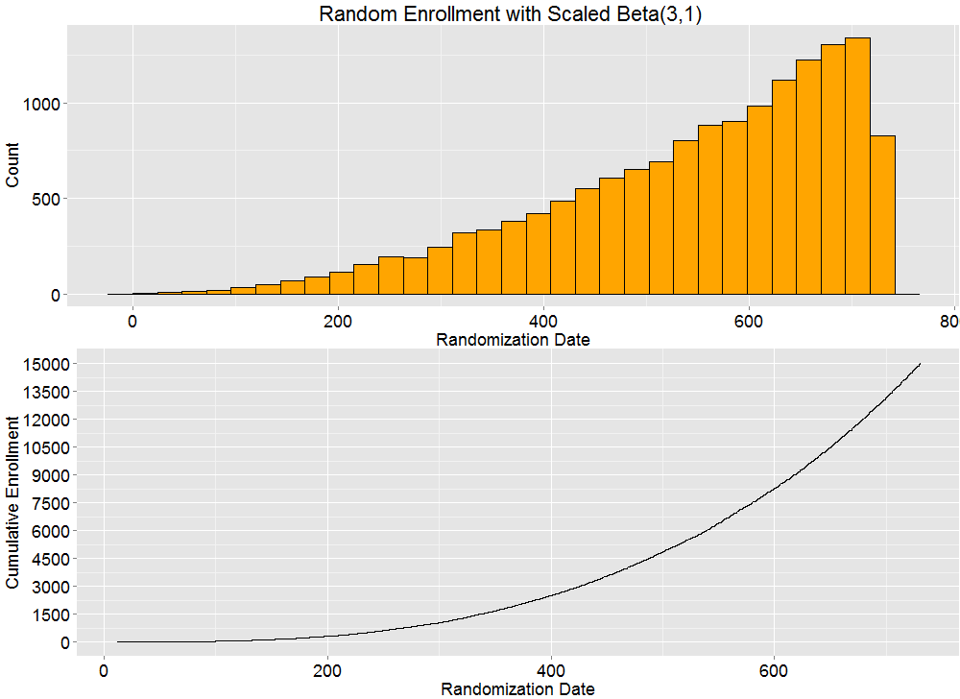
Recurrent Event Analysis Simulation: Enrollment

Slide 97
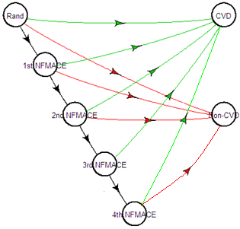
Competing Risks and MACE Components
Visualize the possible paths patients take
State 1
State 6
State 2
State 3
State 7
State 4
State 5

Slide 98
Generating Recurrent Event Data
Assumptions
Non-Fatal/Fatal MACE split: 80%/20%
Treatment effect: HR = 0.845 (presumed common)
Simulation needs to:
Generate state transition times for each patient
Determine each subject’s path into absorbing states
Adjust path times due to enrollment
Determine when target no. of 1st MACE occurs
Censor subject paths and event times accordingly

Slide 99
From Event Rates To Event Times
Transition times ~ iid piecewise exponential
switch times t = (t₁ = 30, t₂ = 365)
state-specific parameters based on assumptions for fatal/non-fatal MACE split and non-cv death
 |  | Simulation Scenarios
 | Annualized Event Rate | 1 | 2 | 3 | 4 | 5 | 6
First MACE | 1st Year | 7.5 | 7.5 | 7.5 | 7.5 | 7.5 | 7.5
 | Thereafter | 3.5 | 3.5 | 3.5 | 3.5 | 3.5 | 3.5
Reset After Subsequent MACE | 1st 30 Days | 7.5 | 15 | 15 | 22.5 | 22.5 | 22.5
 | Remainder of 1st Year | 7.5 | 7.5 | 15 | 15 | 15 | 22.5
 | Thereafter | 7.5 | 7.5 | 7.5 | 7.5 | 15 | 15
Non-CV Death | Common | 0.3584541%

Slide 100
Methodologies considered in simulation
Event frequency approaches
Poisson regression
Chi-Square goodness of fit
T-test on incidence
Time to Event Approaches
Anderson-Gill (common baseline hazards)
Prentice, Williams, Peterson (baseline hazards may differ)
Common Treatment Effect
Uncommon Treatment Effect
Wei, Lin, Weissfeld (Baseline hazards may differ)
Common Treatment Effect
Uncommon Treatment Effect

Slide 101
Communicating the Findings
Event Rate Version |  | HR = .845 |  |  |  |  |  | HR = 1
 |  | 1 | 2 | 3 | 4 | 5 | 6 | 1 | 2 | 3 | 4 | 5 | 6
Prentice Williams Peterson | Common Effect | 0.904 | 0.921 | 0.916 | 0.925 | 0.937 | 0.933 | 0.050 | 0.045 | 0.054 | 0.050 | 0.059 | 0.065
 | 1st Event | 0.881 | 0.891 | 0.892 | 0.872 | 0.893 | 0.872 | 0.055 | 0.046 | 0.053 | 0.056 | 0.062 | 0.051
 | 2nd Event | 0.105 | 0.165 | 0.163 | 0.262 | 0.273 | 0.264 | 0.059 | 0.047 | 0.052 | 0.048 | 0.048 | 0.052
 | 3rd Event | 0.320 | 0.042 | 0.031 | 0.083 | 0.058 | 0.074 | 0.279 | 0.033 | 0.038 | 0.040 | 0.046 | 0.054
Wei Lin Wiessfeld | Common Effect | 0.904 | 0.916 | 0.915 | 0.920 | 0.942 | 0.923 | 0.052 | 0.043 | 0.053 | 0.050 | 0.057 | 0.065
 | 1st Event | 0.882 | 0.891 | 0.892 | 0.869 | 0.892 | 0.872 | 0.055 | 0.045 | 0.054 | 0.056 | 0.061 | 0.051
 | 2nd Event | 0.302 | 0.509 | 0.524 | 0.674 | 0.682 | 0.666 | 0.058 | 0.043 | 0.046 | 0.042 | 0.045 | 0.054
 | 3rd Event | 0.000 | 0.114 | 0.105 | 0.223 | 0.223 | 0.236 | 0.000 | 0.031 | 0.033 | 0.041 | 0.050 | 0.043
Land Mark | 1st Event | 0.881 | 0.891 | 0.892 | 0.872 | 0.894 | 0.872 | 0.055 | 0.045 | 0.053 | 0.056 | 0.062 | 0.051
 | 2nd Event | 0.104 | 0.165 | 0.163 | 0.261 | 0.270 | 0.263 | 0.058 | 0.047 | 0.051 | 0.047 | 0.049 | 0.052
 | 3rd Event | 0.000 | 0.031 | 0.027 | 0.082 | 0.057 | 0.071 | 0.000 | 0.032 | 0.035 | 0.036 | 0.043 | 0.053
Simple | Anderson-Gill | 0.903 | 0.920 | 0.917 | 0.926 | 0.939 | 0.928 | 0.051 | 0.043 | 0.054 | 0.047 | 0.057 | 0.064
 | Poisson Regression | 0.938 | 0.957 | 0.961 | 0.969 | 0.982 | 0.975 | 0.073 | 0.118 | 0.117 | 0.154 | 0.161 | 0.169
 | T-test | 0.933 | 0.949 | 0.951 | 0.955 | 0.970 | 0.965 | 0.068 | 0.095 | 0.089 | 0.117 | 0.128 | 0.126
 | Chi-Square | 0.887 | 0.874 | 0.889 | 0.913 | 0.913 | 0.917 | 0.060 | 0.058 | 0.067 | 0.064 | 0.068 | 0.077
 | Annualized Event Rates | 1 | 2 | 3 | 4 | 5 | 6
First MACE | 1st Year | 7.5 | 7.5 | 7.5 | 7.5 | 7.5 | 7.5
 | Thereafter | 3.5 | 3.5 | 3.5 | 3.5 | 3.5 | 3.5
Reset After Subsequent MACE | 1st 30 Days | 7.5 | 15 | 15 | 22.5 | 22.5 | 22.5
 | Remainder of 1st Year | 7.5 | 7.5 | 15 | 15 | 15 | 22.5
 | Thereafter | 7.5 | 7.5 | 7.5 | 7.5 | 15 | 15
P-values Color Scheme | [.04-.06) | [.06-.10) | [.1-.2) | [.2, .3) | [.3-.4) | [.4-.6) | [.6-.8) | [.8-.88) | [.88-.92) | [.92-.95) | [.95-1)

Slide 102
Reduce, reuse, recycle
Solving these mini problems associated with this simulation laid ground work for related problems
Philosophy after study start: simulations should condition on best available data
Need to model enrollment
Evolved to project when enrollment will end and assist study team with contingency planning
Need to model time to event
Evolved to project interim analyses and study end timelines
Evolved to explore impact of delayed treatment effects and determine if increasing # of events mid trial is advisable
New problems:
Contending with data lag
Contending with evolving assumptions
When to upgrade aspects of the simulation (engine and output)

Slide 103
Simulation Size: How large is large?

Slide 104
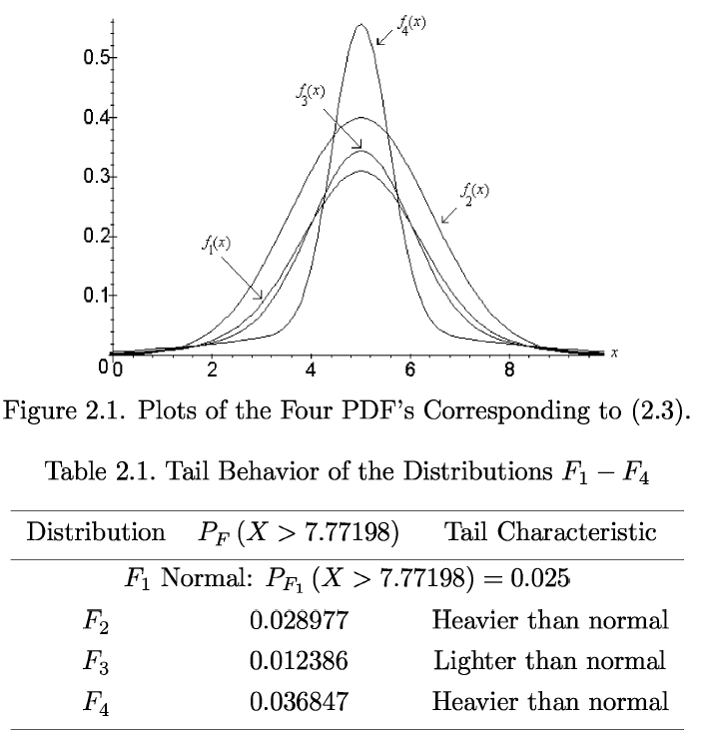
A Toy Problem
Investigate the performance of t-test when samples size is small and data originates from non-normal distributions.
Measure of Interest: Type I error – how far does it deviate from nominal 5%.

Slide 105
Simulation Size Viewed as a Sample Size Determination Problem
Let θ be the type I error probability associated with the 5% level t-test
A simulation iteration does the following:
Sample m observations from population F
Run t-test, get t-statistic
If t-statistic > t_{m-1,.05}, record 1, else record 0 → U₁, …, U_{n}
Q: How many iterations do we need?
We’re accustomed to let sample size be determined by some power criteria in a hypothesis testing setting.
Here our objective is point estimation-based criteria

Slide 106
Specifying the simulation size
Consider the CLT in this setting:
Suppose we want the variance of our estimator to be bounded by c
θ is unknown, but we know variance is maximized when θ = 0.5
So if we want
In our setting P(type I error) lives around .05, so we might choose
c = 0.001² → n > 250,000

Slide 107
Commentary and Extension
A gross overestimate was used in providing an upper bound on the variance.
Underlying Problem: The optimal simulation size under our bounded variance criteria is a function of the target of your inquiry! I.e.,
n*(θ, c) = θ(1- θ)/c
When F is the normal distribution, we know θ is 0.05 and the optimal simulation size would be
n*(.05, c=.001²) = 47500
Can we do better?
What if we assume upper bound of θ₀ for θ: 0< θ < θ₀

Slide 108
A more rigorous alternative to determining simulation size
Background: Sequential Estimation is concerned with point and interval estimation whenever sample size is not fixed.
Based on a pilot data set, we decided to either stop or continue sampling
Sampling following the pilot may be
one-by-one (purely sequential procedure)
a single batch (2-stage procedure)
First in a batch and then one-by-one (accelerated sequential)
Etc.
Bottom line: Since the final sample size (here, number of iterations) is determined based on criteria specified a priori + observed data, the number of iterations is a random variable.

Slide 109
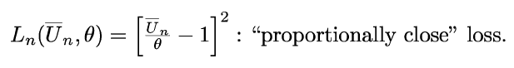
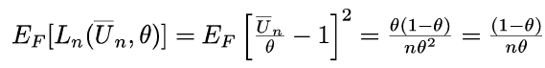
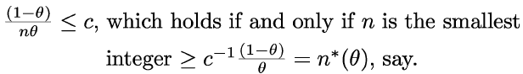
A rigorous alternative to determining simulation size
Instead of a bounded variance criteria
Consider a loss function:
And its associated risk:
A bounded risk criteria still demands knowledge of θ.

Slide 110
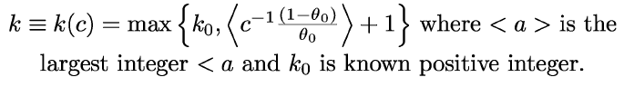
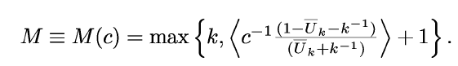
A Two-Stage Simulation Procedure
Pilot sample size: Assume we know: 0< θ < θ₀
k₀ and θ₀ is chosen by experimenter.
Run the first k iterations. Then determine how many iterations are required to complement the simulation:
Run to get a total of M.
Collect U₁, …,U_{M} and estimate θ.

Slide 111
Properties of the Stopping Rule
Recall: n*(θ) is the optimal simulation size to estimate θ with bounded risk c.
As n*(θ) → ∞
M/n*(θ) → 1 in probability
E_{θ}[M/n*(θ)] → 1
E_{θ}[L_{M}/c] → 1 where L_{M} the loss function evaluated with M iterations
Take home message: Given more than just a passing thought to simulation size.
Treat it as a sample size determination problem.
Invest more in the problem when you require high precision estimates and need to consider computing time.

Slide 112
Closing Remarks

Slide 113
Closing Remarks
Simulation is a process of recreating the features of your study
Repeatedly
Using a computer
Allowing for an element of randomness
Helps teams to appreciate risks and balance them appropriately
Assumptions are required
Be prepared to make them!
Discuss reasonable parameters with KOLs
Use historical information and literature
Consider simulating over a grid of values if little is known about key parameters
But consider whether you can put a prior distribution on parameter values and integrate (or simulate) over them

Slide 114
Closing Remarks
Practice makes perfect
You will find ways to make your simulation more efficient
Sometimes you do not need to simulate all the patient observations, e.g. you may be able to sample a series of sample means

Slide 115
Backup

Slide 116
Ancillary Problems in Drug Development

Slide 117
Background for the Problem
Setting: Gathering of key project team lines
Objective: Attack the problems associated with closing out a 15k patient outcomes trial
One Problem: Does data management have enough people power
Manage the rising backlog of existing queries
Tackle the wave of queries to come at study close
Complete work to meet delivery deadline to statistical department

Slide 118
Attacking the Problem
Make a connection with similar problem types
Soliciting information from colleagues: what’s going to help them make a decision?
Soliciting assumptions from colleagues based on their experience/expectations
What might this ‘wave of queries’ look like?
How quickly can queries be attacked.

Slide 119
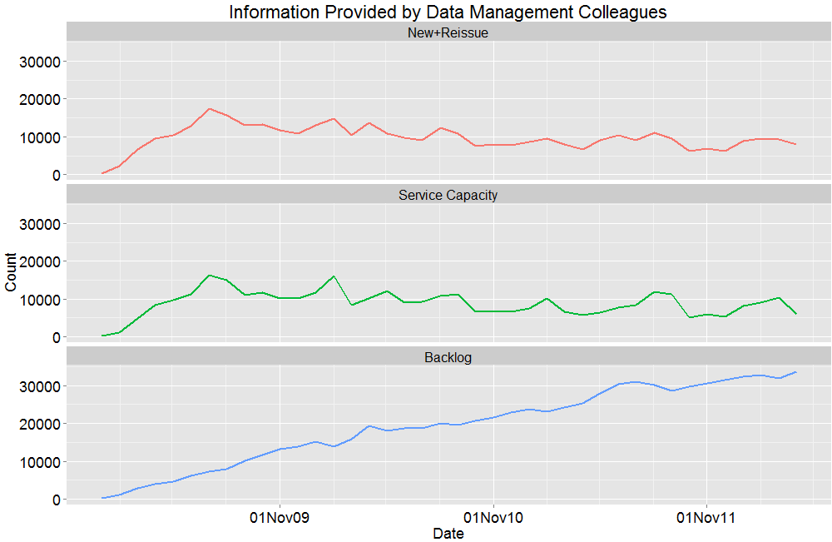
Data

Slide 120
Assumptions Provided by Colleagues
For remainder of 2012
New + Reissue should follow historic pattern
Service Capacity should behave ‘normally’
Possible scenarios for 2013
Jan-April
New + Reissue: 1.5x-3x the historic pattern
Service capacity: 1x-3x historic peak rate
May-June
New + Reissue: .25 the historic pattern
Service capacity: as above
Question: Over this grid of scenarios, what is the distribution of the Backlog complete date

Slide 121
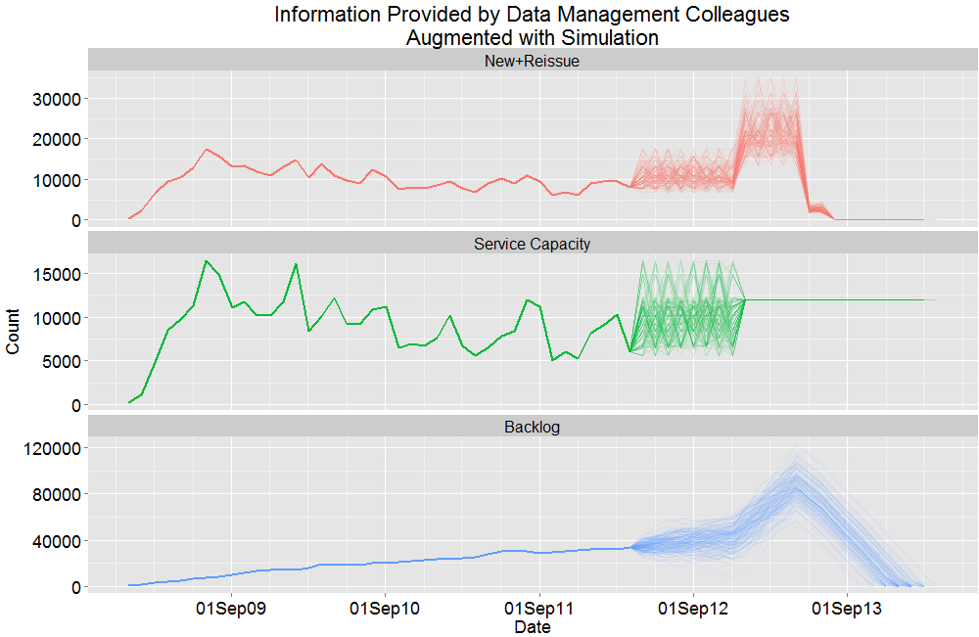
The Do Nothing Scenario

Slide 122
Comparing Notions of Power vs. Assurance via Simulation

Slide 123
Power vs. Assurance
θ is presumed fixed.
Fix θ = θ₀
θ has a prior, π(θ)
For Loop
For Loop
Sample data from f(x|θ =θ₀)
Record 1 if reject, 0 if retain
Sample θ from π(θ)
Sample data from f(x|θ =θ₀) Record 1 if reject, 0 if retain
Estimate Power with
Average of 0’s and 1’s
Estimate Assurance with Average of 0’s and 1’s
Please see references.

Slide 124
Change assumption regarding prior
Power vs. Assurance
Q. How does Assurance behave when
Prior is normal
Centered at value presumed for treatment effect
We increase the number of events associated with prior
Q. How does Assurance behave when
Prior is normal
Treatment effect drifts from the presumed treatment effect towards the null
We fix the number of events associated with the prior

